Slide 1





Dr. Brandon Keith Lacey, Sr.
Dean of Graduate & Online Programs
903-923-1657
Dr. Racquel Cunningham
Assistant Dean of Graduate & Online Programs
903-353-1171
SCHOOL OF GRADUATE &
ONLINE PROGRAMS

Slide 2




WHAT IS CREDIT FOR PRIOR LEARNING?
Credit for Prior Learning is a rewarding process through which students document their learning from experience to earn college credits. A portfolio is built by matching a college course within a declared Wiley University degree program with the knowledge and skills gained by professional or life experience (work, through volunteerism, independent self-directed study, travel, etc.).
In awarding credit for such non-traditional learning, the University will review and evaluate documents such as certificates, publications, test scores, licenses, job performance appraisals, and the like and award credit if the assessment identifies the learning as creditable, relevant and college level.

Slide 3
BENEFITS OF CREDIT FOR PRIOR LEARNING
EFFICIENCY
TIME
COST
Prevents using resources towards skills you’ve already learned.
Reduces up to 8 courses (24 credits) required to earn a degree.
Significantly reduces the overall cost of education.

Slide 4
HOW IT WORKS
1
2
3
Identify possible courses using degree plan and syllabi.
Submit application for assessment and pay applicable fees.
Enroll in and complete MANA 3300 course.
4
Submit portfolio to be assessed.
5
Portfolios are assessed by a certified faculty member.
6
Approved portfolios will be added to the student's transcripts by the university registrar.

Slide 5
PORTFOLIO BREAKDOWN

Slide 6
COST & FEE STRUCTURE
APPLICATION FEE
ASSESSMENT FEE
DISCOUNTED TUITION
$25 (PAID UP FRONT)
$150 (due along with portfolio submission)
$60 per credit hour ($180 per 3 credit course).

Slide 7
Q & A

Slide 8

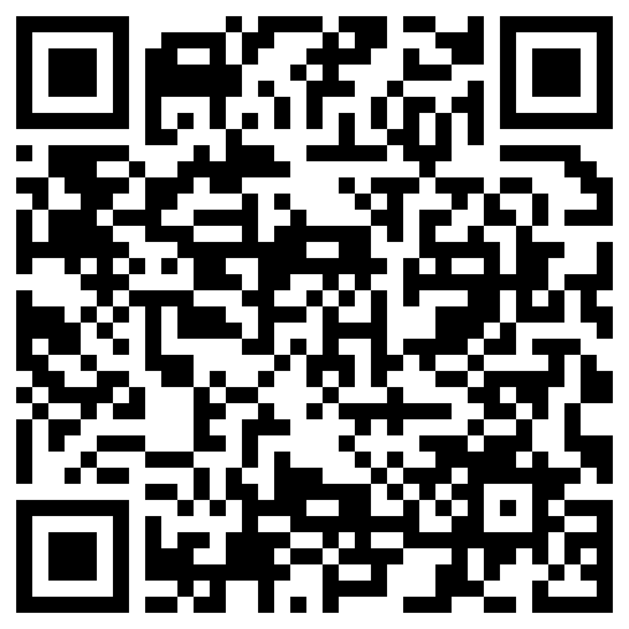

Slide 9

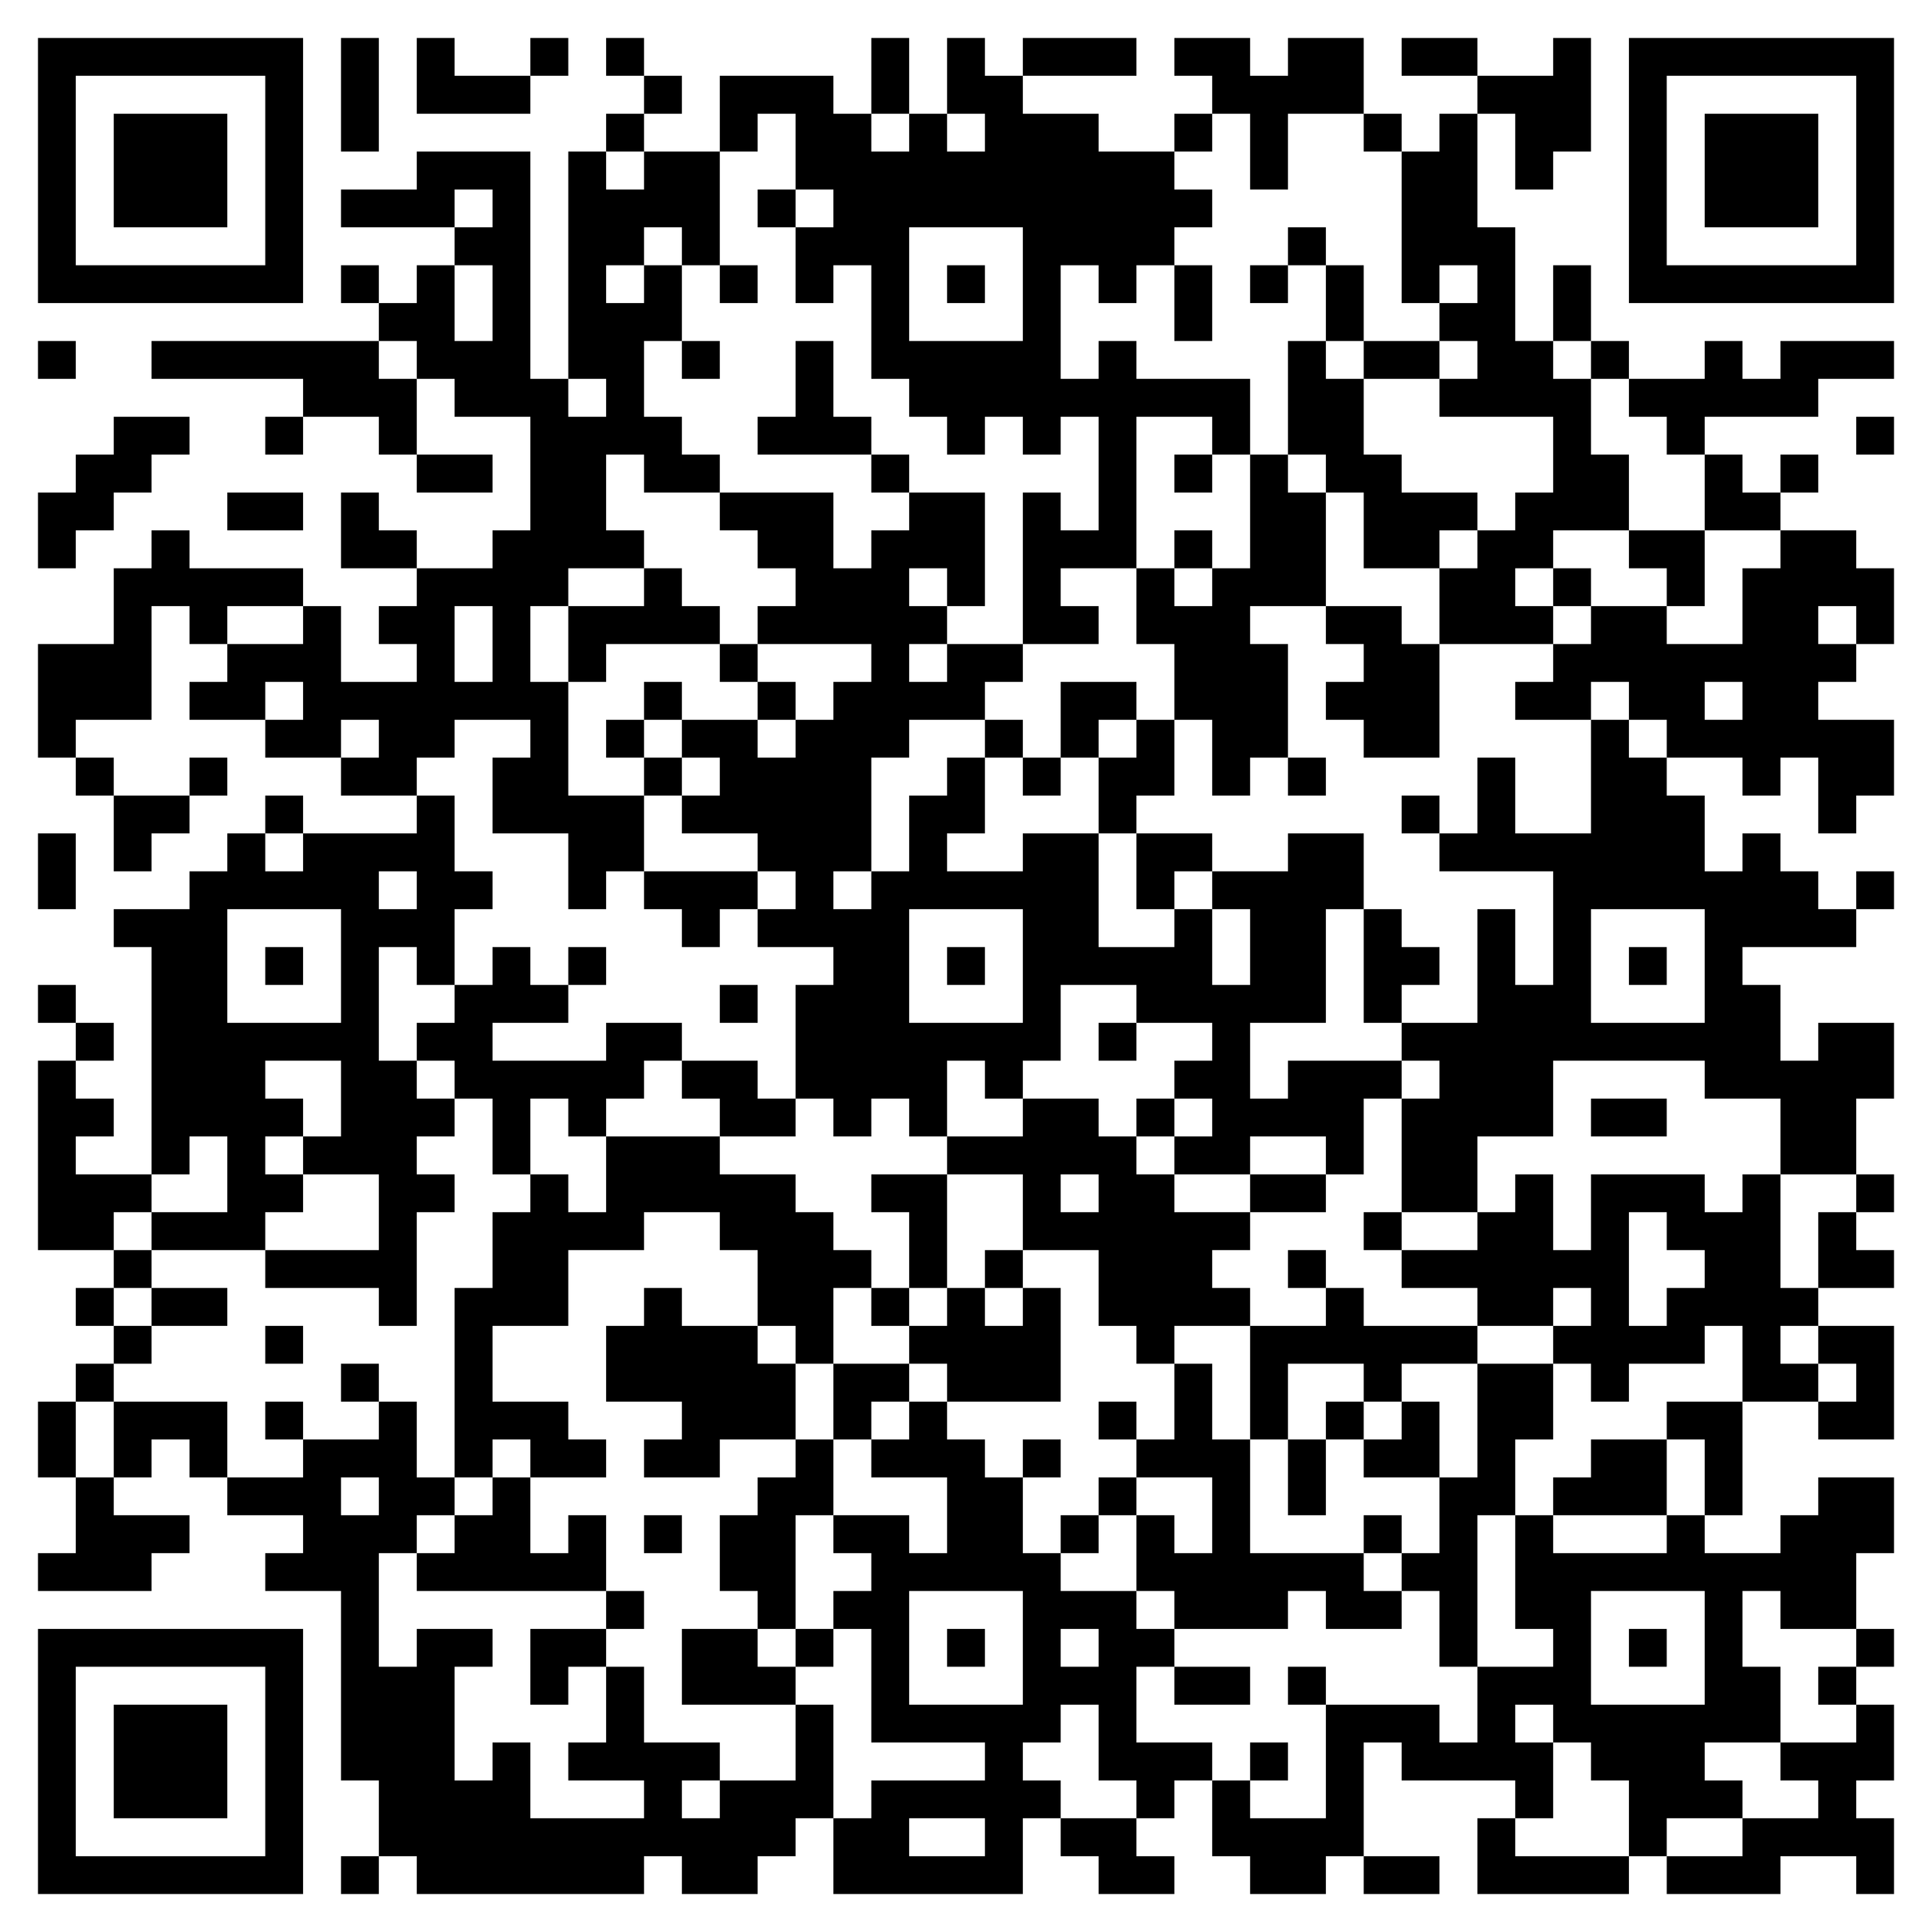

APPLICATION FOR ADMISSION

